Slide 1
Week 13:
Information Retrieval
W266: Natural Language Processing

Slide 2
Peeking ahead...
Week 1- 2: NN Basics & Training
Week 3: Classification & Sentiment
Week 4: Part of Speech + Parsing
Week 5: Convolutional Neural Networks (CNNs)
Week 6 - 7: Language Models
Week 8: Machine Translation
Week 9: Advanced MT: Transformers & Transfer Learning
Week 10: Entities/Information Extraction
Week 11: Summarization and a touch of question answering
Week 12: Document Processing
Week 13: Information Retrieval
Week 14: In-class Presentations

Slide 3
Announcements
Semester is wrapping up…
April 10 (This Saturday): Project Due 11:59pm PST
You must use this form for submitting your projects
One submission per group!
April 12 - 17: Your In-Class Presentations

Slide 4
Announcements (continued)
Paper reading sessions:
Train Large, Then Compress: Rethinking Model Size for Efficient Training and Inference of Transformers
Joachim: Thursday, 04/08, Noon PST

Slide 5
Feedback Please!
End of semester feedback is now open!
https://course-evaluations.berkeley.edu
We are always working on changes to improve the class. If you have ideas, please feel free to *also* reach out if your ideas don’t fit the feedback template.

Slide 6
The plan...
Review:
Last Week: Document Processing
Previous Weeks: NLP
Information Retrieval (IR)
Overview
Infrastructure
Ranking and Evaluation
Neural IR Models

Slide 7
Review

Slide 8
Last Week: Document Processing
An unsolved problem with multiple independent strategies:
Use existing approaches on short sections and find ways to stitch information together, i.e., exploit hierarchical structure.
Break into chunks and combine weights for each chunk
Build representations of words, sentences, and sentence blocks
Relax size constraints of existing BERT-derived approaches and hope they give more meaningful results. (It is a long way though from 500 to 500k ...)
Use altogether different architectural approaches to targeted problems
Combine hierarchical and sequential approach
Twin encoders

Slide 9
Last Week: Document Processing
Different NLP tasks require different strategies:
Classification is more amenable to a bag of words approach
Summarization needs to consider the sentences in the entire document
Recommendation needs a representation of the entire document
Coherence assessment needs to be built up sequentially

Slide 10
Previous Weeks: NLP
What are some common NLP problems?
What are the advantages and disadvantages of word embeddings?
What are some common approaches to sentence classification?
What kinds of architectures are used to perform sentence classification?
What are some common approaches to machine translation?
What kinds of architectures are used to perform machine translation?
What are language models and what are they used for?

Slide 11
Previous Weeks: NLP
What problem(s) does a pointer generator network architecture solve?
What is the function of attention in an RNN encoder-decoder architecture?
What is the Transformer Architecture?
What are 3 pre-trained Transformer models and their differences
How can we use BERT to perform classification? Multiple choice selection? Question-answering? NER?

Slide 12
Information Retrieval

Slide 13
Information Retrieval
Find text, satisfy “information need”
Not quite NLP, but related and intertwined
ACL vs ACM SIGIR
NLP often critical component of IR
IR ideas often appear in NLP

Slide 14
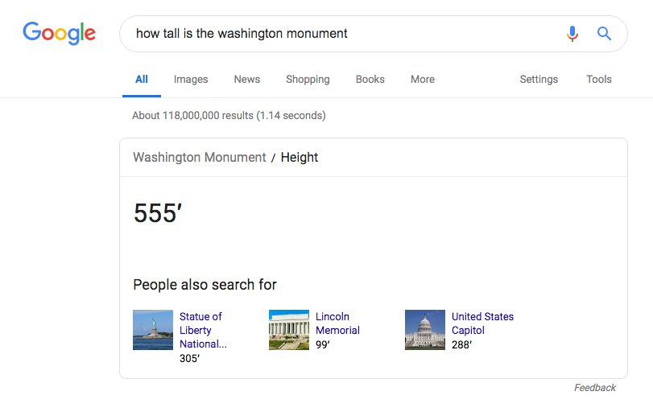

Slide 15


Slide 16
NLP and IR
(Modern) IR uses lots of NLP techniques
Text (pre)-processing
Textual similarity
Entity identification and resolution
Structured interpretations / QA

Slide 17
IR and NLP
Challenges:
Huge amount of information! (the web)
Hard to evaluate “relevance”
Hard to measure recall
Similar challenges for many NLP tasks:
Summarization: what’s a good summary?
Question Answering: what’s a good answer?
Translation: good translation, might not match reference

Slide 18
IR Implementation & Infrastructure

Slide 19
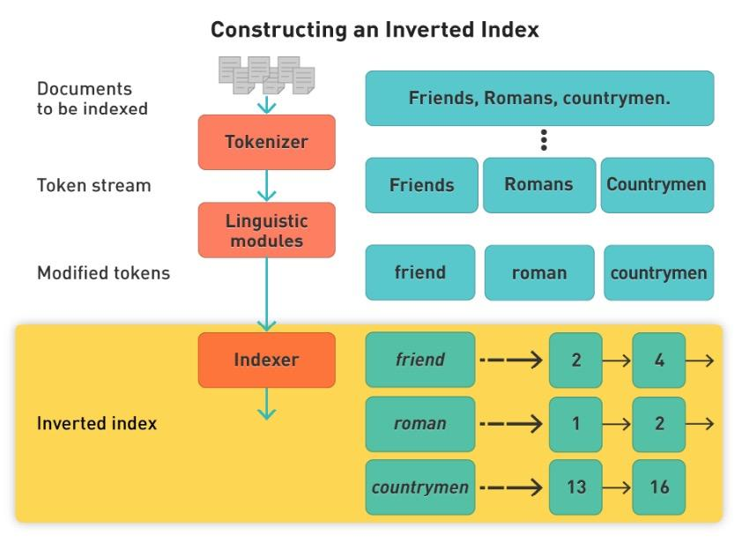
IR: Inverted Index
Like a back of book index - words/phrases point to list of page numbers
Query terms must match index keys
Query and index get identical pre-processing
Index keys can match tokens or multi-token annotations
Notes:
Need to construct in a distributed manner too!

Slide 20
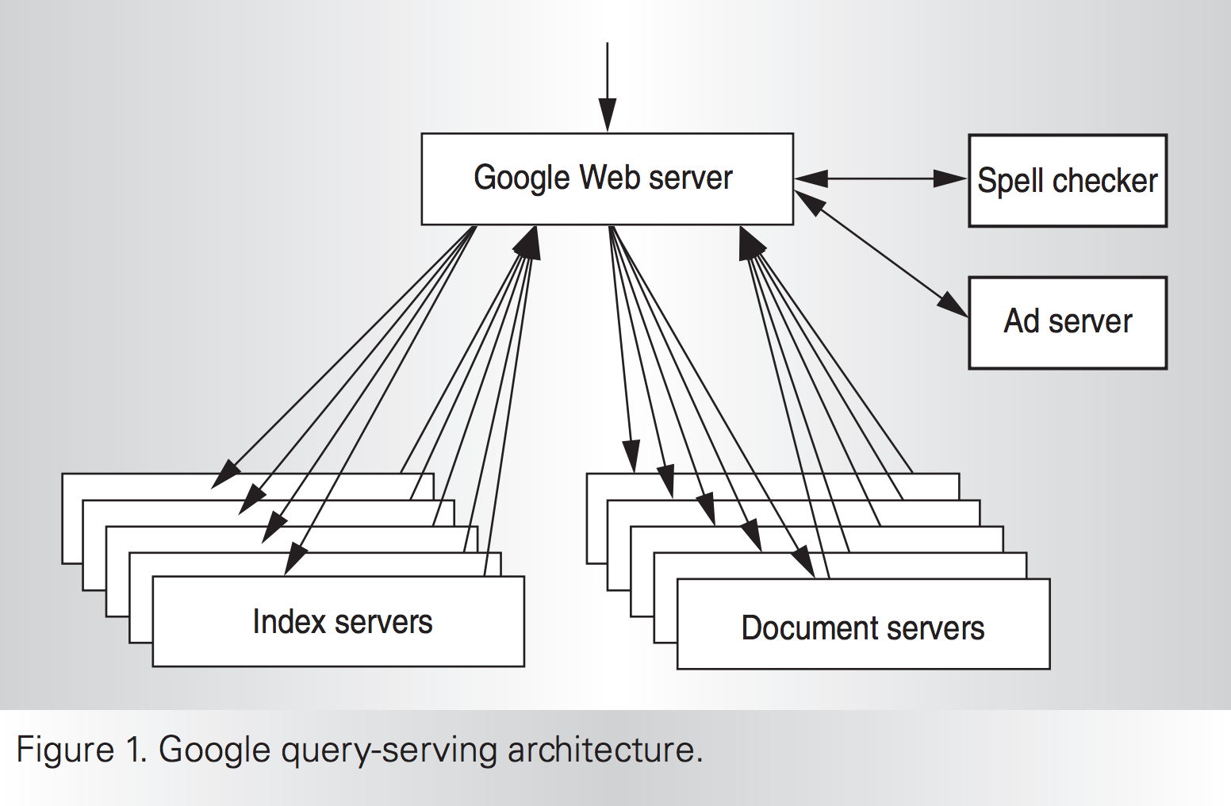
IR: Distributed Infrastructure
Notes:
Need to construct in a distributed manner too!

Slide 21
Ranked Retrieval

Slide 22
Why rank?
Unranked Search
Return a large unsorted collection of docs that match the query
Does the user have to look at all docs to meet their information need?
Ranked retrieval
Return sorted collection of docs that match the query from most to least “relevant”
Let user keep reading down ranked list until their information need is met
Relevance ranking is central to modern information retrieval

Slide 23
Representations and Relevance in IR
BOW approach
Represent document(s) and query as sparse vector of words with scores
tf*idf is exemplar
Relevance is a function of word frequencies in and across docs
Semantic approach
Create dense vector representation of documents and query
Latent space captures semantic relations between all words
Relevance is a function of location in shared latent space

Slide 24
Ranking: tf.idf
Term Frequency (TF):
The number of times each query token appears in the document
Proxy: How relevant is this document to this word?
Inverse Document Frequency (IDF):
log N/n_{t}
Proxy: Balance between words
Notes:
IDF proxy is “how informative is this word, overall?”

Slide 25
Ranking: tf.idf
[hello]
IDF(hello) = 0.1
Doc 1 TF: 6
Doc 2 TF: 8
Does IDF matter?

Slide 26
Ranking: tf.idf
[hello]
IDF(hello) = 0.1
Doc 1 TF-IDF: 6*0.1 = 0.6
Doc 2 TF-IDF: 8*0.1 = 0.8
Does IDF matter?

Slide 27
Ranking: tf.idf
[hello world]
IDF(hello) = 0.1
IDF(world) = 8
Doc 1 TF(hello): 20, TF(world): 0
Doc 2 TF(hello): 1, TF(world): 1
Does IDF matter?

Slide 28
Ranking: tf.idf
[hello world]
IDF(hello) = 0.1
IDF(world) = 8
Doc 1 TF(hello): 20, TF(world): 0
TF-IDF(hello)=20*0.1=2 TF-IDF(world)=0*8=0
Doc 2 TF(hello): 1, TF(world): 1
TF-IDF(hello)=1*0.1=0.1 TF-IDF(world)=1*8=8
Does IDF matter?

Slide 29
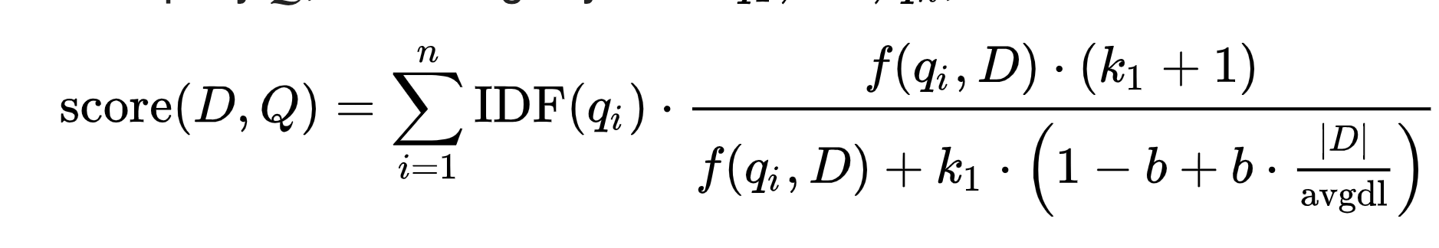
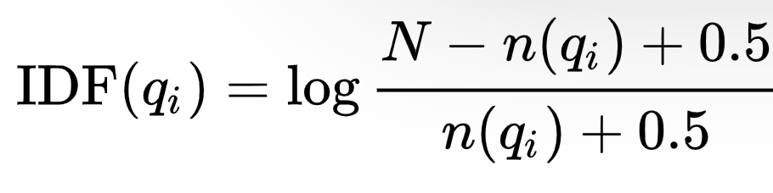
Ranking: Better tf*idf
Okapi BM25 - Length normalized tf*idf, often a very strong baseline
|D| is document length and avgdl is average document length in corpus
k1 and b are tunable parameters
N is the total number of documents in the collection, |D| is doc length, avgdl is avg. doc length.
Calculated term by term - no phrases
Source: Wikipedia article on BM25 ranking algorithm

Slide 30
Evaluation Metrics

Slide 31
Ranked Retrieval Evaluation
How do we evaluate?
True: sorted list of (document, relevance)
Predict: sorted list of (document, predicted relevance)
Need to do ranking comparison! Many choices:
Mean Average Precision (MAP)
NDCG
Kendall’s Tau, Spearman’s Rho

Slide 32
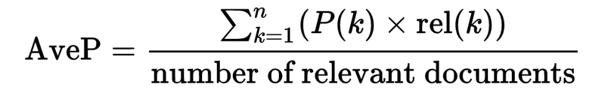
Mean Average Precision (MAP)
Mean Average Precision ~= AUCpr
Idea: average precision for retrieving each relevant document
MAP = average of AvpP over all queries
Notes:
where
k is the rank in the sequence of retrieved documents,
n is the number of retrieved documents, {
P(k) is the precision at cut-off k in the list (so … from i=1,2,...,k)
rel(k) is an indicator function equaling 1 if the item at rank k is a relevant document, zero otherwise.
Note that the average is over all relevant documents and the relevant documents not retrieved get a precision score of zero.

Slide 33
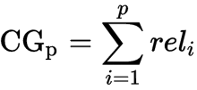
Cumulative Gain
Sum of relevance scores for documents 1… p
Problems?
Notes:
Problems: doesn't pay attention to order or returned results and it also unnormalized (different queries will have different maximum values)

Slide 34
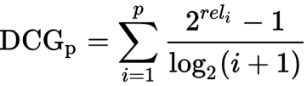
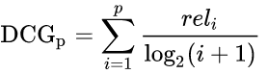
Discounted Cumulative Gain
There are two common formulations of this...
Rank normalized sum of relevance scores for documents 1...p
Problems?
Notes:
Good: Order matters, now
Problems: Still unnormalized across queries (/different queries will have different maximum values)

Slide 35
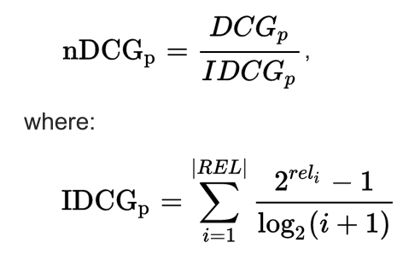
Normalized Discounted Cumulative Gain
REL represents a perfectly ordered list of relevant documents in the corpus up to retrieval position p. IDCG_{p} is the maximum DCG_{p} score, achieved by the perfect ordering.

Slide 36
Rank Correlation
Kendall’s Tau: pairwise ordering accuracy
Consider all pairs (x_{i}, x_{j}) with scores y_{i}, y_{j}
𝝉 = (# pairs correctly ordered - # pairs incorrectly ordered)
(# total pairs)
Normalized difference between correctly vs. incorrectly ordered document pairs.
Notes:
Over all pairs, not just adjacent ones. Thus the denominator is N choose 2.

Slide 37
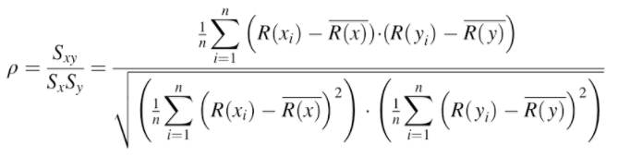
Rank Correlation
Spearman’s Rho: rank correlation
Rank true scores, predicted scores
Compute Pearson correlation between lists of ranks
Ex: true = [1,2,3,4], pred = [3,2,1,4]

Slide 38
Neural IR Models

Slide 39
Neural IR models - Two Approaches
Relevance models learn to score (long) documents by (short) queries
Focus on producing a relevance score for each doc relative to the query
Build representations focused on term relevance
Semantic similarity models score text pairs by meaning similarity
Focus on longer natural language queries/questions.
Build representations focused on semantic meaning.

Slide 40
Neural IR models - Representations
Query representations
Query is a short low dimensional vector (like embeddings)
Document representations
Do we represent sentence(s), passage(s), or document as low dimensional vector?
Ranking/Relevance representations
Relevance as a probability (e.g. P(D|q) or P(q|D)

Slide 41
TRANSFORMER LIKE BERT
[CLS] Query tokens [SEP] [CLS] Doc Sent 1 [SEP] [CLS] Doc Sent 2 [SEP]...

Slide 42
Learning to Rank Example

Slide 43
Deep Relevance Matching Model (DRMM)
Introduces Relevance Matching function:
Exact matching signals - term occurs in query AND doc
Calculate term importance in queries
Diverse matching - relevance match can occur anywhere in the document
Contrasts with Semantic Matching:
Semantic similarity (doc and query are semantically similar)
Meaning of overall chunk of text rather than set/sequence of words
Globally match whole doc to query
Adapted from Guo et. al., 2016, A Deep Relevance Matching Model for Ad-hoc Retrieval

Slide 44
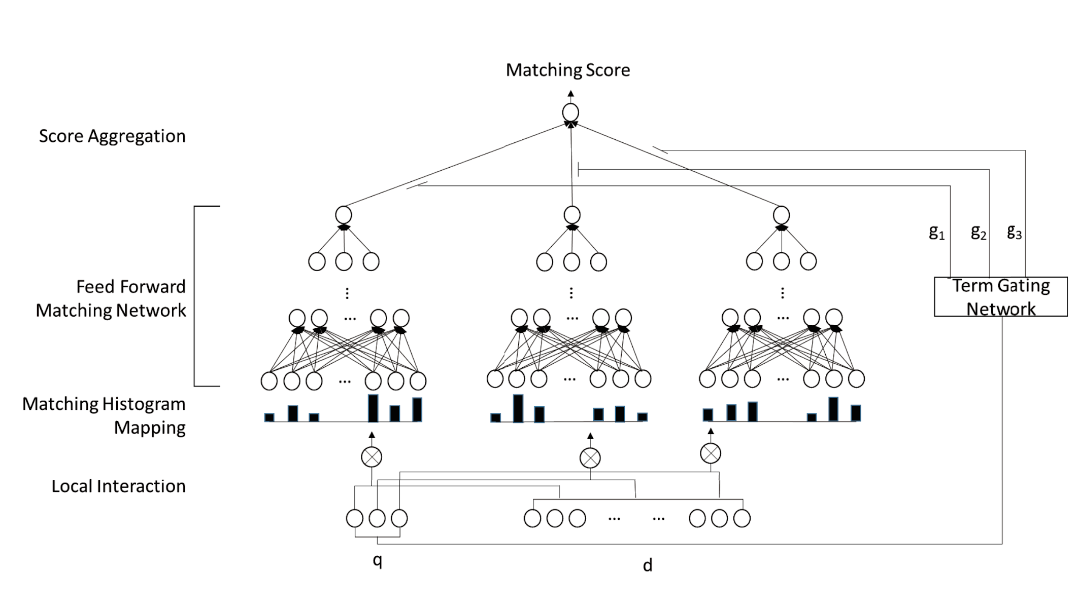
DRMM structure
Word2vec embeddings for doc and query terms minus stopwords.
Each query term compared to all doc terms to construct a matching histogram.
Histogram fed to FFMN to produce query term score
Gating function rates query terms in importance to “relevance”
Query term scores aggregated to produce relevance score
Adapted from Guo et. al., 2016, A Deep Relevance Matching Model for Ad-hoc Retrieval

Slide 45
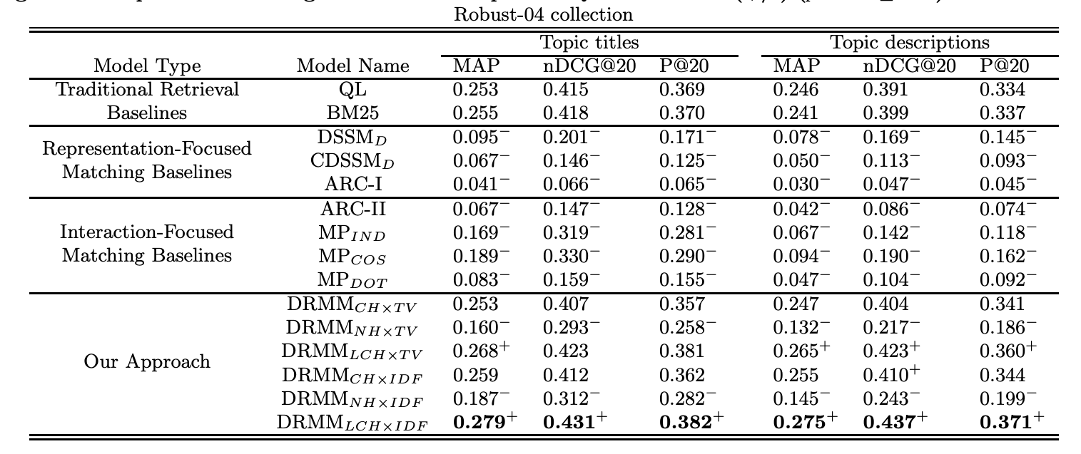
DRMM Results
Some improvement over BM25 baseline for count histogram and log-count histogram.
Fundamentally a BOW model!
Adapted from Guo et. al., 2016, A Deep Relevance Matching Model for Ad-hoc Retrieval

Slide 46
Semantic Similarity Example

Slide 47
USE-Semantic Retrieval
Extension of Universal Sentence Encoder
(“Universal Sentence Encoder”, Cer et al, https://arxiv.org/pdf/1803.11175.pdf)
Seeks to create latent semantic space into which docs and queries can be mapped
Trained on multiple tasks
conversation response prediction
Quick Thought
Natural language inference (NLI)
bilingual text retrieval
Tested on a semantic retrieval task
Identify all sentences in retrieval corpus that are semantically similar to a query sentence
Adapted from Yang et. al., 2019, Multilingual Universal Sentence Encoder for Semantic Retrieval

Slide 48
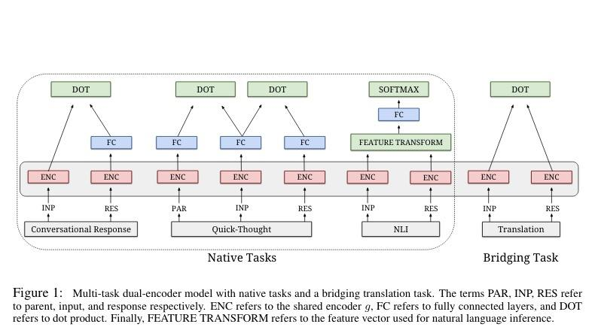
Universal Sentence Encoder (USE) Family
Dual Encoder Architecture
Two encoders with shared parameters learn to produce representations (sentence embedding) that maximizes similarity (dot product) between dual encoder outputs.
Based on Chidambaram et. al., 2019, Learning Cross-Lingual Sentence Representations via a Multi-task Dual-Encoder Model

Slide 49
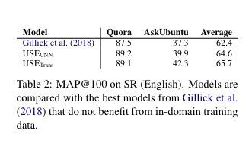
USE - Semantic Retrieval Results
Fine-tuned on large sets of question answer pairs.
Identify different questions that have the same answer:
What is your age?
How old are you?
These are semantically similar.
Query on one should retrieve all others
Adapted from Yang et. al., 2019, Multilingual Universal Sentence Encoder for Semantic Retrieval

Slide 50
BERT Example

Slide 51
Q: “What is the height of the washington monument”
D1: “.....”
D2: “.....”
D3: “.....”
[CLS] What is the height of the washington monument [SEP] D1 [SEP]

Slide 52
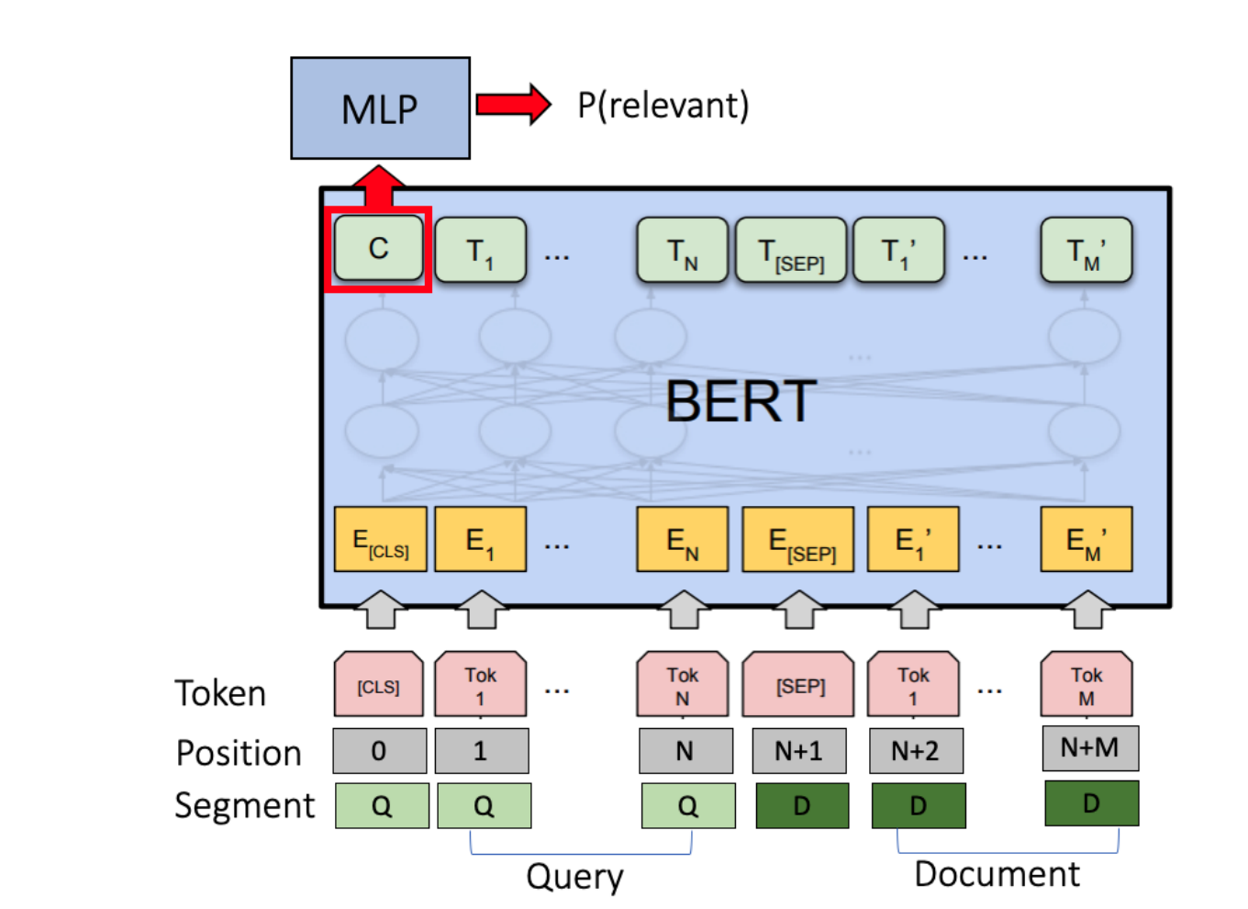
IR using BERT
Simple adaptation of BERT
[CLS] as sentence or passage vector
Binary relevance classifier
Doc relevance based on passage level scoring
First passage, Max passage, Sum Passage
Fine-tuning on query logs
Question: Is this a relevance match model or a semantic match model?
Based on Dai and Callan, 2019, Deeper Text Understanding for IR with Contextual Neural Language Modeling

Slide 53
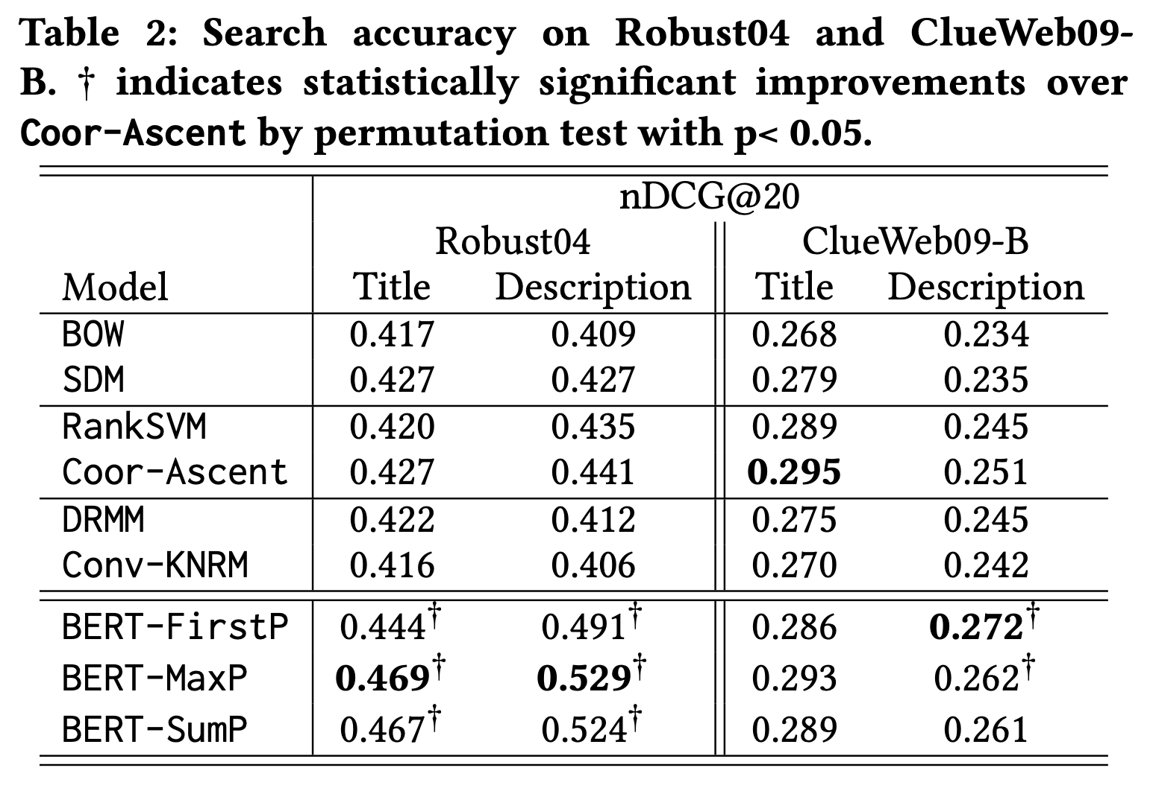
IR using BERT
Does BERT help retrieval?
Seems better on natural language queries
Stopwords are a problem in tf*idf but mark key semantic relations
Where are wind power installations located? There are 1200 wind power installations in Germany.
BERT language model captures “language understanding” - fine-tuning on query/doc pairs adds “search knowledge.”
Based on Dai and Callan, 2019, Deeper Text Understanding for IR with Contextual Neural Language Modeling

Slide 54
Next Week: Your Presentations
End of This Week: Projects Due April 10th!

Slide 55
Thanks for a great class!

Slide 56
P(doc | q) -- same score for Vijay and Salman and we don’t separate the data for Vijay or his likes vs Salman or his likes
P(doc | q, user = Vijay) -- this is based on selections or data from Vijay (user) and when data is unavailable from Vijay, people similar (ex: similar queries overall, similar GPS location, similar websites, ….) to Vijay

Slide 57
Checking in on the Async...
Group exercise...

Slide 58
Edit distance
What is the edit distance of "peach" and "patch"?

Slide 59
Edit distance
2
What is the edit distance of "peach" and "patch"?

Slide 60
Spelling correction
The noisy channel spelling model computes the unnormalized probability P(believe|beleiv) as the product of what terms?

Slide 61
Spelling correction
p(typed | intended) x p(intended)
Unnormalized as we ignore the p(typed) in the denominator. Why can we do this?
The noisy channel spelling model computes the unnormalized probability P(intended|typed) as the product of what terms?

Slide 62
Positional Index
True or False? The original documents can be reconstructed from a positional index.

Slide 63
Positional Index
True!
True or False? The original documents can be reconstructed from a positional index.

Slide 64
Jaccard Coefficient
True or False? You could implement token-level Jaccard coefficient ranking using a non-positional index.

Slide 65
Jaccard Coefficient
True!
True or False? You could implement token-level Jaccard coefficient ranking using a non-positional index.

Slide 66
tf-idf Ranking
True or False? IDF has an effect on ranking for one-word queries.

Slide 67
tf-idf Ranking
False!
tf(doc1, word)*IDF(word) vs tf(doc2, word)*IDF(word)
relevance(doc) = sum(tf(doc, word)*IDF(word))
Ex: relevance(doc|query=”the apple”) = tf(doc, “the”)*IDF(“the’) + tf(doc, “apple”)*IDF(“apple”)
Ex: relevance(doc|query=”apple”) = tf(doc, “apple”)*IDF(“apple”)
True or False? IDF has an effect on ranking for one-word queries.

Slide 68
Vector Space Model
relevance(doc) = vector_sum(tf(doc, word)*IDF(word) along the direction of the dimension for word)
doc = “the apple the”
tf(doc) = (0, 0, ... 2, 0, …, 0, 1, 0, ...) tf-idf(doc) = (0, 0, ... 2/9, 0, …, 0, 1/5, 0, ...)
True or False? An index without positional information has all the information necessary to compute TF-IDF scores.

Slide 69
Vector Space Model
True!
True or False? An index without positional information has all the information necessary to compute TF-IDF scores.

Slide 70
Evaluating IR
True or False? The precision/recall curve ignores potentially relevant documents not in the top-k ranked results.

Slide 71
Evaluating IR
True!
True or False? The precision/recall curve ignores potentially relevant documents not in the top-k ranked results.

